Slide 1
Canape – Examining
the VMware ESXi Protocol
Alex Chapman
Notes:
I have no imagination when it come to presentation names.

Slide 2
What we are going to talk about?
New Version of Canape Released at Ruxcon
What is the VMware ESXi management protocol?
In Canape:
MitM
Traffic Parsing
Traffic Injection
Fuzzing
Extending Canape
Finding 0 days

Slide 3
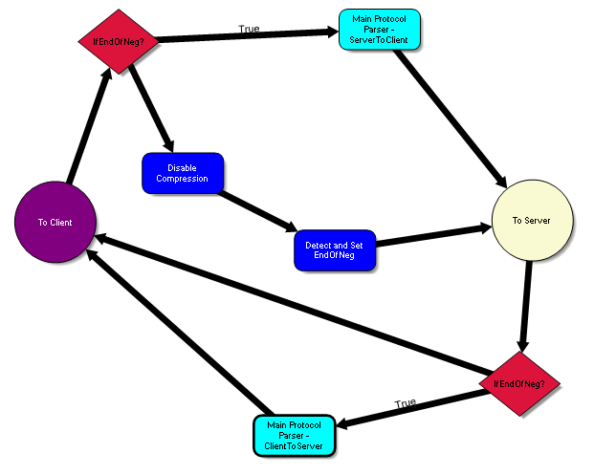
What is Canape?
Network Protocol Testing Tool
Existing Tools:
HTTP Proxies (e.g. CAT)
Echo Mirage
Python Libraries
Wireshark
Why a new tool?
Has these features and more
All driven through a GUI
And it’s free!

Slide 4
The old way
Notes:
Disadvantages:
Wireshark – Monitor only tool, does not play well with encryption (except TLS with RSA key exchange)
Python/Ruby – Lots of code duplication. Code focused, not protocol focused

Slide 5
The Canape way
GUI driven IDE for protocol analysis
Focus on data rather than code
Large number of built in modules to parse / modify / fuzz traffic
Large number of supported languages for when coding is necessary
C#, Python, Ruby, Visual Basic, Jscript .NET
Even F# (if you really want)

Slide 6
How does it Capture Traffic?
MitM support
SOCKS
Port Forwarding
Network protocol support
TCP, UDP, Broadcast traffic
Application level proxy
HTTP, SSL

Slide 7
What is the VMware ESXi protocol?
Protocol used for network management of VMware virtualisation products
Actually numerous protocols
Remote desktop
File transfer
Etc.
Requires a bespoke client
Notes:
Actually used for ESXi, Workstation and even Player

Slide 8
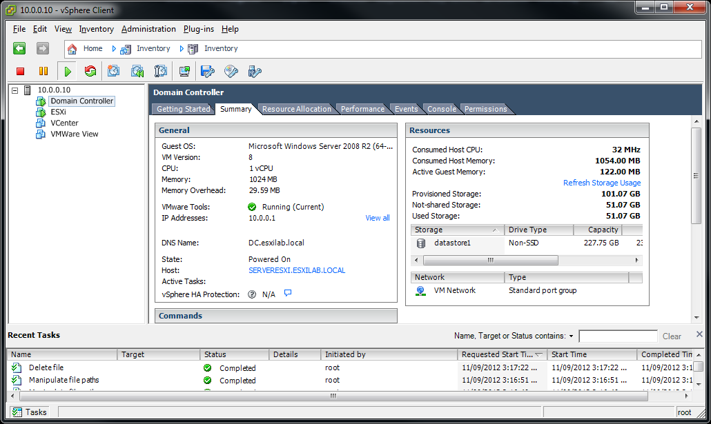
VMware vSphere Client

Slide 9
The protocol(s)
Actually multiple protocols over one connection
Authentication
Remote Desktop
Network File Copy
VMware Database
Each time the protocol transitions a new SSL encrypted or plain text stream is initiated on the same connection
Notes:
Multiple SSL streams on the same connection causes issues with “traditional” MiTM proxies.

Slide 10
MitM Traffic
Notes:
Demo: Basic MitM demo.
This demo will show basic protocol capture using Canape.

Slide 11
State handling
The ESXi protocol traverses a number of protocol states
Or
Banner
SSL Auth
SSL VNC
Banner
SSL Auth
NFC
Notes:
Note: NFC occurs over plain text connections by default

Slide 12
Handling State Transitions
Notes:
Demo: State transition demo.
This demo will show how Canape can transition handling of different protocols on the same connection, in this case between the Authentication and Remote Desktop protocols.

Slide 13
Authentication protocol
Text based protocol
Simple commands
BANNER
USER
PASS / XPAS
SESSION
PROXY / CONNECT
Allows for Username/Password, Ticket and Session authentication

Slide 14
Basic Network Clients
Notes:
Demo: Bruteforcing credentials demo.
This demo will show creating a basic network client to brute force user credentials against ESXi.

Slide 15
Remote desktop
Based on the VNC protocol
Includes VMware specific extensions
Commands
Hello
Negotiation
User Input
Screen redraw
Etc.
Notes:
http://www.realvnc.com/docs/rfbproto.pdf

Slide 16
Key press
0x00
0x30
0x01
0x00
a
?
Scan Code
Flags
?
0x00
0x30
0x00
0x0

Slide 17
Mouse movement
0x5F3F0000
0x7FA90000
0x01000000
0xFFFFFFFF
0x00000000
X Coordinate
Y Coordinate
?
?
Flags
Button State
0x00000000 – No Buttons
0x00000001 – Press Left
0x00000002 – Press Middle
0x00000004 – Press Right
0x00010000 – Scroll Down
0xFFFF0000 – Scroll Up

Slide 18
Parsing User Input
Notes:
Demo: User input parsing demo.
This demo will show parsing portions of the VMware Remote Desktop protocol in Canape.

Slide 19
Traffic Injection
Notes:
Demo: Traffic injection demo.
This demo will show injecting key press traffic into the live protocol stream.

Slide 20
NFC protocol
Simple file transfer protocol
Unencrypted by default(!)
Allows for
File upload
File download
File move
File copy
File delete
Notes:
Post authentication protocol, requires a valid NFC session to access

Slide 21
Fuzzing
Standard everyday fuzzing
But from within in the protocol stream
Built in modules for
Simple byte fuzzing
Integer fuzzing
Pattern fuzzing
Etc.
Custom fuzzers written in code

Slide 22
Fuzzing
Notes:
Demo: Fuzzing demo.
This demo will show basic fuzzing of the post authentication NFC protocol

Slide 23
What did we find?
5 Heap Memory Exhaustion Panics
2 Unhandled Exceptions
2 Null Pointer Dereferences
1 Use After Free Vulnerability
Context are currently working closely with the VMware Security Response Center to fix the identified issues
Notes:
If the Hostd service crashes twice within 1 minute it will not restart causing a Denial of Service requiring manual restart of the service via SSH or direct console access.
Note: These numbers and identified issues are still to be finalised, more are expected before Ruxcon.

Slide 24
Mitigating the risk
Restrict access to management services to management IP Addresses
Don’t use the NFC file transfer to transfer sensitive files
Enable SSH

Slide 25
Extending Canape
Sulley
Protocol Informatics
Notes:
Depending on time demo Sulley and Protocol Informatics extensions
https://github.com/OpenRCE/sulley
http://phreakocious.net/PI/
https://github.com/wolever/Protocol-Informatics

Slide 26
Thanks
Thanks to the following people:
James Forshaw, Canape author and implementer of many requested features and bug fixes
Michael Jordon, for continued support and pushing me to do this talk!

Slide 27
References
http://canape.contextis.com
www.twitter.com/#ctxis
Notes:
Updated slides and worked VMware ESXi Canape example will be made available on the Context website shortly after Ruxcon, watch this space.

Slide 28
Questions
?

